Slide 1
Java Installation Structure

Slide 2
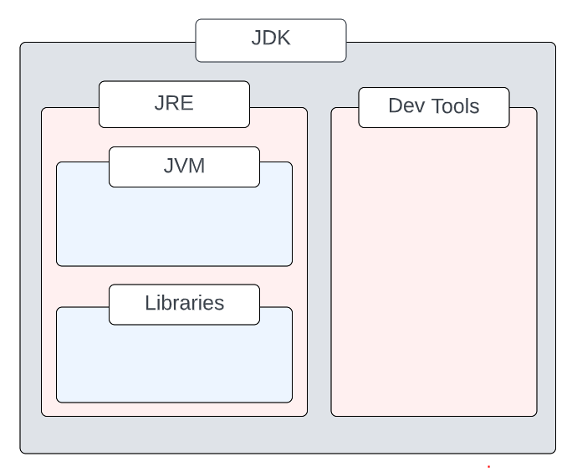
Java Structure
JDK = JRE + tools to develop Java Application
JRE = JVM + libraries to run Java application

Slide 3
JVM
JVM acts as interpreter in JAVA
Libraries
These libraries are just a collection of classes which are predefined in JAVA.
Ex : java. lang, java. util

Slide 4
JRE
The Java Runtime Environment (JRE) is a software package which bundles the libraries (jars) and the Java Virtual Machine To run applications written in java
With out JRE we can not run the Java program

Slide 5
JDK
Development Tools
Development tools are used for developing, debugging, and monitoring Java applications.
Compiler, Jar creation are some of tools.

Slide 7
JVM Architecture

Slide 8
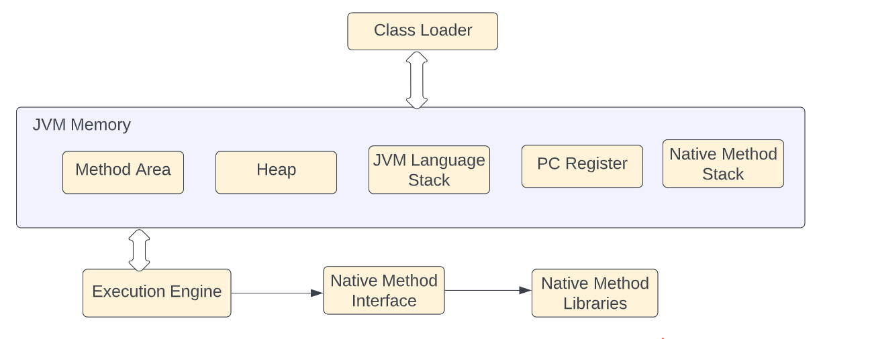
JVM Architecture

Slide 9
Class Loader
The class loader is used for loading the class files.
Three Phases of Class loader
Loading
BootStrap
Extension
Application
If class is not found, then classnotfoundexception will be thrown.
Linking
Initialization

Slide 10
JVM Architecture

Slide 11
Execution Engine
Interpreter
JIT compiler
Garbage collector

Slide 12
JVM Architecture

